Slide 1
California Real Estate:
A Global Perspective
April 27, 2026
Global Summit
Michael Falk
Public Policy Economist
California Association of REALTORS®

Slide 2
Setting the stage
California housing struggles often get explained as a local problem
But California’s unique global economic, financial, and cultural position means that housing demand is increasingly global
At the same time, supply is still local
That mismatch is what we’ll explore

Slide 3
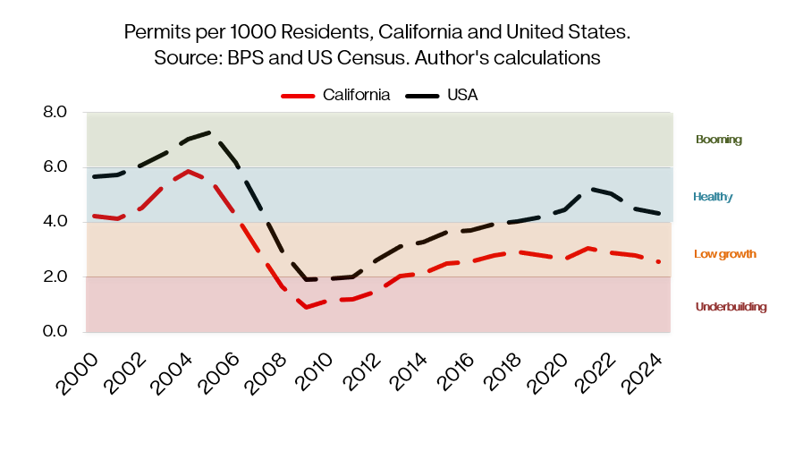
Setting the stage: California’s constrained housing supply

Slide 4
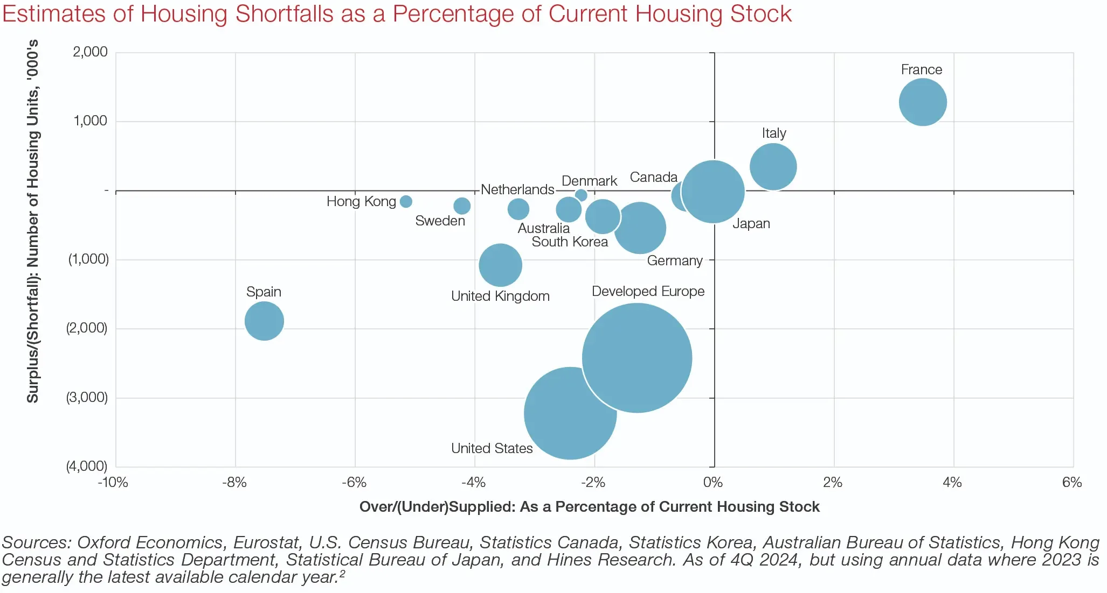
We are not alone: much of the world is facing supply pressures

Slide 5
Who’s buying?
Chinese buyers are the largest foreign cohort, spending $13.7B on US homes April 2024–March 2025, with 36% choosing California
LA and SF are hotspots, and so are luxury homes: LA had nearly 1 in 5 luxury shoppers from abroad at peak post-wildfire demand
Foreign individual buyers skew toward for-sale, not rental
Bottom line: Foreign buyers are competing for limited existing supply
Foreign individual buyers mostly reshuffle existing supply rather than add new units

Slide 6
What draws foreign buyers to California?
Wealth preservation: stable legal system, strong property rights
Education pipeline: proximity to top universities (LA, SF, Irvine)
Global brand + lifestyle: internationally recognized markets
Constrained supply: scarcity supports long-term value
California sits at the intersection of global wealth, education, and limited housing supply

Slide 7
How does foreign demand manifest?
What it DOES
Concentrates in coastal + high-end markets
Competes for existing homes
Can move prices at the margin in luxury segments
What it DOESN’T do
Does not increase supply
Does not drive many transactions (~1.9% of sales)
Does not explain our housing supply issues

Slide 8
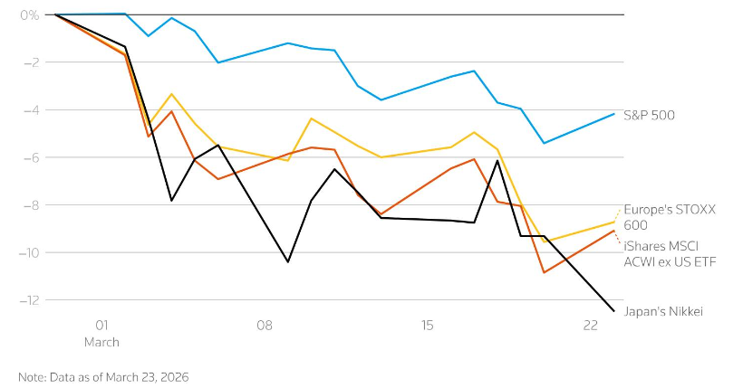
Stock markets, war risk, and capital flight all feed into the health of the luxury real estate market
Stock indexes since Iran war began
SOURCE: LSEG, Lewis Krauskopf, Reuter
Notes:
Source: https://www.reuters.com/business/iran-fallout-us-shares-hold-up-better-than-global-rivals-now-2026-03-24/

Slide 9
Luxury home sales move with financial-market wealth

Slide 10
California is a top destination for many foreign buyers
Note: 1.9% of total existing home sales are from foreign buyers
(1st)
(2nd)
(2nd)
(2nd)
(t-1st)
(3rd)

Slide 11
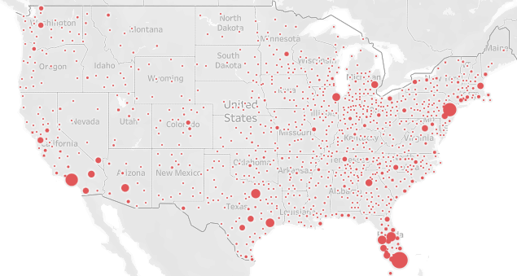
Markets where international buyers are most interested
Top markets viewed by international home shoppers
Rank | Market | Traffic Share
1 | Miami-Fort Lauderdale-West Palm Beach, FL | 8.4%
2 | New York-Newark-Jersey City, NY-NJ | 5.6%
3 | Los Angeles-Long Beach-Anaheim, CA | 4.8%
4 | Orlando-Kissimmee-Sanford, FL | 2.7%
5 | Dallas-Fort Worth-Arlington, TX | 2.7%
12 | Riverside-San Bernardino-Ontario, CA | 1.4%
19 | San Diego-Chula Vista-Carlsbad, CA | 1.1%
20 | San Francisco-Oakland-Fremont, CA | 1.1%
Source: Realtor.com - 2025Q3 International Demand Report
Notes:
Source: https://www.realtor.com/research/q3-2025-international-demand/

Slide 12
In a nutshell: California’s real estate market is where global capital is running into limited supply
Supply is the constraint
California’s housing shortage is structural
Global capital shapes demand
Foreign buyers compete for existing homes rather than creating new ones
Financial markets are a signal
Watch the markets: luxury housing responds first

